Slide 1
What is Jira?
Jira is a widely used project management tool developed by Atlassian. It helps teams track and manage their work by providing features for task tracking, issue management, and agile project management. With its customizable workflows and collaboration capabilities, Jira is particularly popular in software development and IT teams.

Slide 2
What is Jira?
JIRA is a tool developed by Australian Company Atlassian. It is used for bug tracking, issue tracking, and project management. The name "JIRA" is actually inherited from the Japanese word "Gojira" which means "Godzilla".
The basic use of this tool is to
  track issue and bugs related to your software and Mobile apps.
  It is also used for project management.
The JIRA dashboard consists of many useful functions and features which make handling of issues easy.

Slide 3
Presentation Roadmap
What these tools are
Why we use Atlassian tools
JIRA
How we use them day-to-day
Advice for teams wanting to do the same

Slide 4
Presentation Roadmap
What these tools are
Why we use Atlassian tools
JIRA and Confluence
JIRA and Confluence
How we use them day-to-day
Advice for teams wanting to do the same

Slide 5
Wait, Pizza?
Imagine you run a pizzeria
What happens when a customer orders a pizza?
How do you communicate the status of the pizza to your customer?

Slide 6
My Pizza Story
ORDER PLACED
PREP
BAKING
BOX
OUT FOR DELIVERY
DELIVERED

Slide 7
My Pizza Story
ORDER PLACED
PREP
BAKING
BOX
OUT FOR DELIVERY
DELIVERED

Slide 8
My Pizza Story
ORDER PLACED
PREP
BAKING
BOX
OUT FOR DELIVERY
DELIVERED

Slide 9
My Pizza Story
ORDER PLACED
PREP
BAKING
BOX
OUT FOR DELIVERY
DELIVERED

Slide 10
My Pizza Story
ORDER PLACED
PREP
BAKING
BOX
OUT FOR DELIVERY
DELIVERED

Slide 11
My Pizza Story
ORDER PLACED
PREP
BAKING
BOX
OUT FOR DELIVERY
DELIVERED

Slide 12
My Pizza Story
ORDER PLACED
PREP
BAKING
BOX
OUT FOR DELIVERY
DELIVERED

Slide 13
My Pizza Story
ORDER PLACED
PREP
BAKING
BOX
OUT FOR DELIVERY
DELIVERED

Slide 14
My Pizza Story
ORDER PLACED
PREP
BAKING
BOX
OUT FOR DELIVERY
DELIVERED

Slide 15
My Pizza Story
ORDER PLACED
PREP
BAKING
BOX
OUT FOR DELIVERY
DELIVERED

Slide 16
My Pizza Story
ORDER PLACED
PREP
BAKING
BOX
OUT FOR DELIVERY
DELIVERED

Slide 17
My Pizza Story
ORDER PLACED
PREP
BAKING
BOX
OUT FOR DELIVERY
DELIVERED

Slide 18
My Pizza Story
ORDER PLACED
PREP
BAKING
BOX
OUT FOR DELIVERY
DELIVERED

Slide 19




My Pizza Story
ORDER PLACED
PREP
BAKING
BOX
OUT FOR DELIVERY
DELIVERED

Slide 20
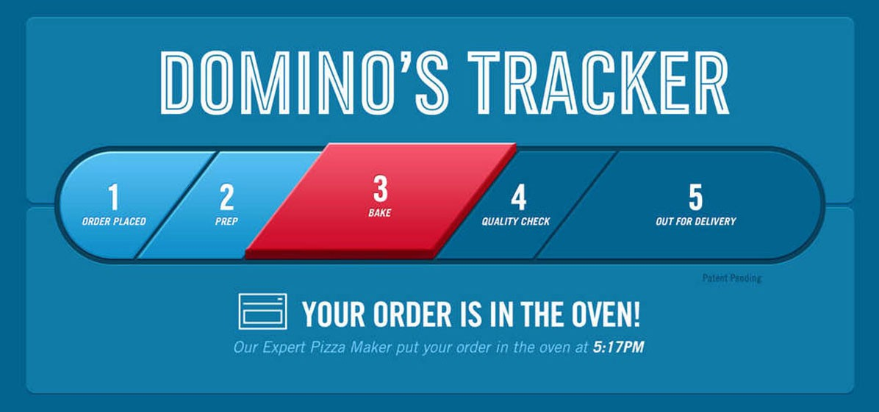

Slide 21
Presentation Roadmap
What these tools are
Why we use Atlassian tools
JIRA and Confluence
JIRA and Confluence
How we use them day-to-day
Advice for teams wanting to do the same

Slide 22
Presentation Roadmap
Why we use Atlassian tools
JIRA and Confluence
JIRA and Confluence
How we use them day-to-day
Advice for teams wanting to do the same

Slide 23
What are JIRA and Confluence
TO DO
IN PROGRESS
DONE

Slide 24
What are JIRA and Confluence
IN PROGRESS
TO DO
DONE
ORDER PLACED
PREP
BAKING
BOX
OUT FOR DELIVERY
DELIVERED

Slide 25



What are JIRA and Confluence?
JIRA is our “pizza tracker”
JSD is “Customer Service”
Confluence is where pizza recipes, guidelines are written and discussed
A pizza can be anything!

Slide 26
Presentation Roadmap
Why we use Atlassian tools
JIRA and Confluence
JIRA and Confluence
How we use them day-to-day
Advice for teams wanting to do the same

Slide 27
Enter JIRA
BACKLOG (TO DO)
All
IN PROGRESS
All
DONE
All

Slide 28
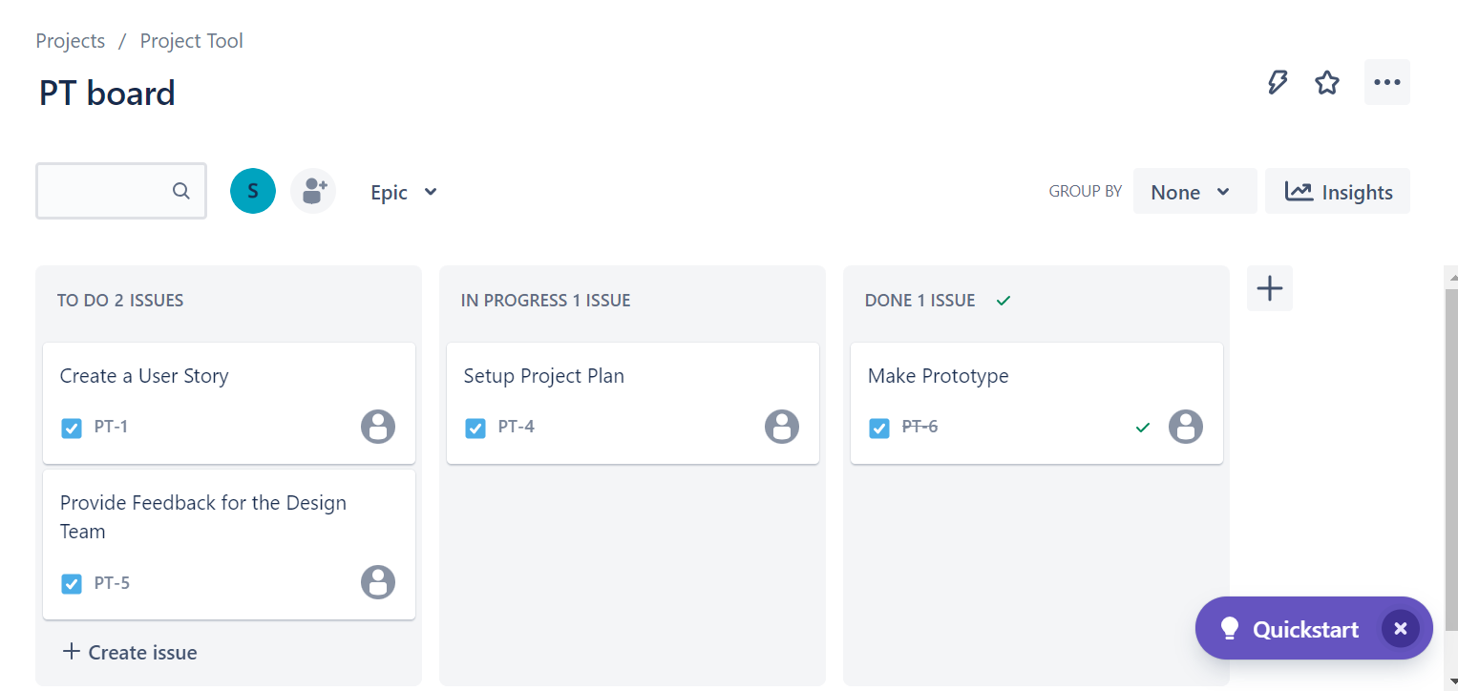
Keeping it All Organized

Slide 29
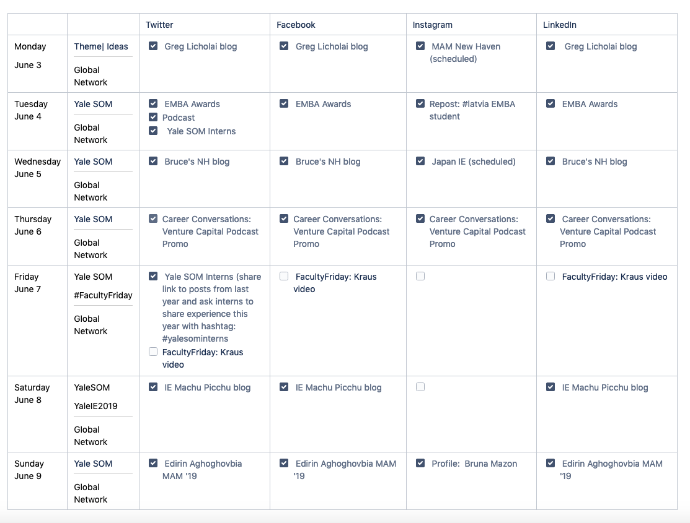
How and Why We Use Confluence
Content Planning
Organization
Historical Data

Slide 30
How we use

Slide 31
Presentation Roadmap
Why we use Atlassian tools
JIRA and Confluence
JIRA and Confluence
How we use them day-to-day
Advice for teams wanting to do the same

Slide 32
Presentation Roadmap
JIRA and Confluence
JIRA and Confluence
Advice for teams wanting to do the same

Slide 33
Presentation Roadmap
JIRA and Confluence
JIRA and Confluence
Advice for teams wanting to do the same

Slide 34

Questions?

